Slide 1
NoSQL
Epita - Spring 2025

Slide 2


Discord
Join #epita-sp25-nosql
https://discord.gg/4rcjT5TUGx

Slide 3





Presentation
Alexis Perrier
Engineer, Data scientist, teacher, nerd
alexis.perrier@epita.fr
Started working with mysql in 2000
Teaching: SciencePo, IPSA, Eifrei, Epita, Gustave Eiffel, Openclassrooms, etc.

Slide 4
Syllabus
Details - Syllabus
What for ?
Use cases
Ecosystem
SQL Comparison
(DNL) queries
Performances
LLMs with vector stores
Schema in MongoDB
Data science in Neo4j
NoSQL
MongoDB
Vector stores
Neo4j

Slide 5
Course Evaluation
1 MongoDB workshop (50%)
1 Neo4j workshop (50%)
Work on a dataset of your choosing

Slide 6
Scope
This is a course on MongoDB, Vector store and Neo4j.
MongoDB: Document database. large volume of data that has flexible schema
Vector databases! Vector search is the building block of LLMs .
Major players now offer vector search, including PostgreSQL, MongoDB, and Neo4J.
There are also dedicated vector databases such as Weaviate, Pinecone, chromadb, ... . we are talking about vector stores .
Neo4J: graph database. particularly effective for certain types of use cases and questions. we'll also look at alternatives.

Slide 7
Prerequisite
Know your computer (Path, install, etc.)
Terminal and Command Line
mongosh
cypher shell
Mac: iTerm
Windows:
git console
Powershell Admin

Slide 8
Tools
Google Drive : Slides and PDFs
Github: scripts and pdf https://github.com/SkatAI/Epita_SP25_NoSQL
Discord: your questions https://discord.gg/4rcjT5TUGx
LLMs: some Answers

Slide 9
Languages
javascript for MongoDB
cypher for Neo4j
python, javascript or your favorite language

Slide 10
AI policy
It would be absurd not to use LLMs
Learn to work with LLMs
How to avoid
cognitive offloading
the rabbit hole
hallucinations
LLMs
DeepSeek, Qwen.ai
Gemini on aistudio.google.com and in Colab
Claude.ai
ChatGPT.com
Mistral
Grok on X
Platforms
windsurf
cursor
claude code
openAI codex
Magnus.im

Slide 11
AI policy
NO PAIN
NO GAIN
You don't get fit by watching workouts on Instagram.
Likewise, you don't learn by letting the LLM do the work.

Slide 12
Why this course?
the global NoSQL market projected to soar from $7.3 billion in 2022 to $86.3 billion by 2032, driven by a 28% annual growth rate
NoSQL is for applications with unpredictable workloads , such as social media platforms, e-commerce sites, and IoT systems
future-proofing your career and standing out in a competitive job market.
Students who learn NoSQL are better prepared to work on cutting-edge technologies like real-time analytics, machine learning , and distributed systems.

Slide 13
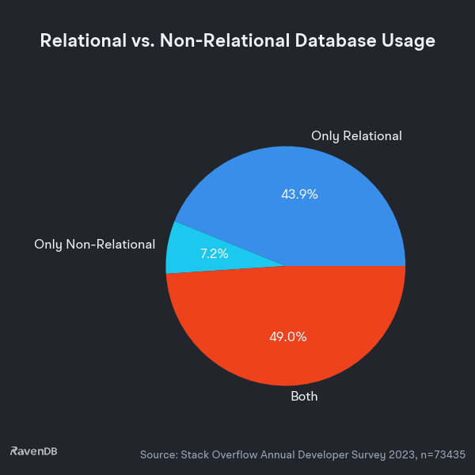
SQL vs NoSQL usage stackoverflow 2023
NoSQL
in parallel
SQL

Slide 14
Questionnaire to find out your expectations
Complete the following questionnaire
https://forms.gle/L87wNPPaH85JT72YA
Then
Join the Discord: https://discord.gg/4rcjT5TUGx
clone the github repo: https://github.com/SkatAI/Epita_SP25_NoSQL
access the slides in Google Drive

